Slide 1


EXPLORATORY DATA ANALYSIS AND ETL
Dr. Bhakti Palkar

Slide 2
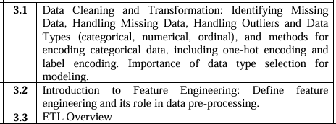
CONTENTS

Slide 3
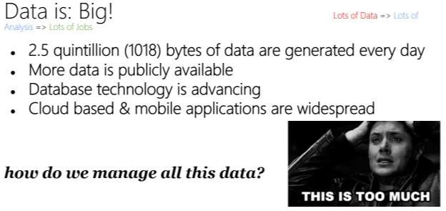
4/26/2022

Slide 4
DATA PREPROCESSING
Data Preprocessing: An Overview
Data Quality
Major Tasks in Data Preprocessing
Data Cleaning
Data Integration
Data Reduction
Data Transformation and Data Discretization

Slide 5
DATA QUALITY: WHY PREPROCESS THE DATA?
Measures for data quality: A multidimensional view
o Accuracy: correct or wrong, accurate or not
Completeness: not recorded, unavailable, …
Consistency: some modified but some not, dangling, …
Timeliness: timely update?
Believability: how trustable the data are correct?
Interpretability: how easily the data can be understood?
4/26/2022

Slide 6
MAJOR TASKS IN DATA PREPROCESSING
Data cleaning
Fill in missing values, smooth noisy data, identify or remove outliers,
and resolve inconsistencies
Data integration
Integration of multiple databases, data cubes, or files
Data reduction
Dimensionality reduction
Numerosity reduction
Data compression
Data transformation and data discretization
Normalization
Concept hierarchy generation
4/26/2022

Slide 7
DATA CLEANING
Steps in Data Cleaning:
Remove Duplicate Data
Identify and eliminate duplicate records that may exist due to multiple data entries.
Handle Missing Values
Fill missing values using techniques like mean, median, or mode imputation.
Remove records with excessive missing values if necessary.
Fix Structural Errors
Correct typos, inconsistent formatting, and incorrect categorizations.
Standardize text formats (e.g., "NY" vs. "New York").
Handle Outliers
Detect and address extreme values using statistical methods like Z-score or IQR.
Decide whether to remove or transform them.
Normalize and Standardize Data
Scale numerical values to a common range for consistency in analysis.
Validate Data Integrity
Ensure logical consistency (e.g., birthdate not in the future).
4/26/2022

Slide 8
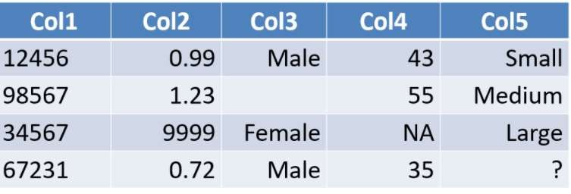
INCOMPLETE (MISSING) DATA
Data is not always available
o E.g., many tuples have no recorded value for several attributes, such as customer income in sales data
Missing data may be due to
o equipment malfunction
o inconsistent with other recorded data and thus deleted
o data not entered due to misunderstanding
o certain data may not be considered important at the time of entry
o not register history or changes of the data
Missing data may need to be inferred
4/26/2022

Slide 9
Handling Missing Values in Data
Missing values can affect data quality and analysis accuracy. Here are common techniques to handle them:
1. Deleting Missing Values
Remove Rows: If only a few records have missing values, drop them.
Remove Columns: If an entire column has too many missing values, consider removing it.
Use with caution: Works best when data loss is minimal.
2. Imputation (Replacing Missing Values)
Mean/Median/Mode Imputation
Numerical data: Replace missing values with mean (for normal distribution) or median (for skewed data).
Categorical data: Use mode (most frequent value).
Forward Fill / Backward Fill
Forward fill: Use previous value to fill missing data.
Backward fill: Use the next available value.
K-Nearest Neighbors (KNN) Imputation
Predicts missing values based on similar data points.
3. Predictive Modeling
Use machine learning models (like regression) to estimate missing values based on other features.
4. Marking Missing Values
Create a new categorical feature indicating whether a value was missing to retain useful patterns.
Choosing the right method depends on the dataset and the nature of missing data.
4/26/2022

Slide 10
Steps to Fix Structural Errors:
Identify Inconsistencies
Check for typos, incorrect spellings, or misclassified data.
Example: "NYC" vs. "New York City" or "Male" vs. "M".
Standardize Formats
Convert date formats to a uniform structure (e.g., YYYY-MM-DD).
Ensure consistent capitalization and naming conventions.
Correct Data Types
Convert numerical data stored as text to proper numeric format.
Ensure categorical data is stored as category-type values.
Merge Similar Categories
Group similar values into a single category (e.g., "USA", "U.S.",
and "United States" → "United States").
Use Automation
Apply regex, scripting, or libraries like Pandas (str.lower(), replace(),
astype()).

Slide 11
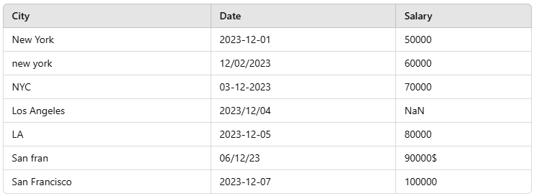
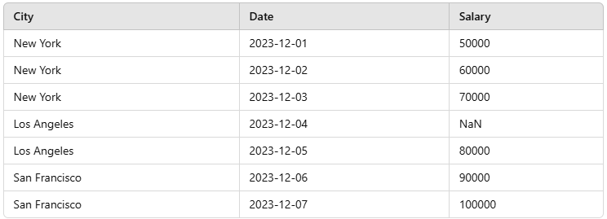
Sample Input (Original Data with Structural Errors)
Sample Output (After Fixing Structural Errors)
Fixes Applied:
City Names Standardized → "new york", "NYC" → "New York"; "LA" → "Los Angeles"; "San fran" → "San Francisco". Date Formats Unified → Converted all date formats to YYYY-MM-DD.
Salary Column Cleaned → Removed $, converted to numeric values.

Slide 12
OUTLIERS
Outliers are extreme values that differ significantly from the majority of the data. They can distort statistical analysis, so handling them properly is crucial.
1. Identify Outliers
Using Visualization:
Box Plot (seaborn.boxplot())
Histogram (matplotlib.hist())
Scatter Plot (matplotlib.scatter())
Using Statistical Methods:
Z-Score Method: Outliers have Z-scores > 3 or < -3
IQR (Interquartile Range) Method: Outliers fall below Q1 - 1.5*IQR or above Q3 + 1.5*IQR

Slide 13
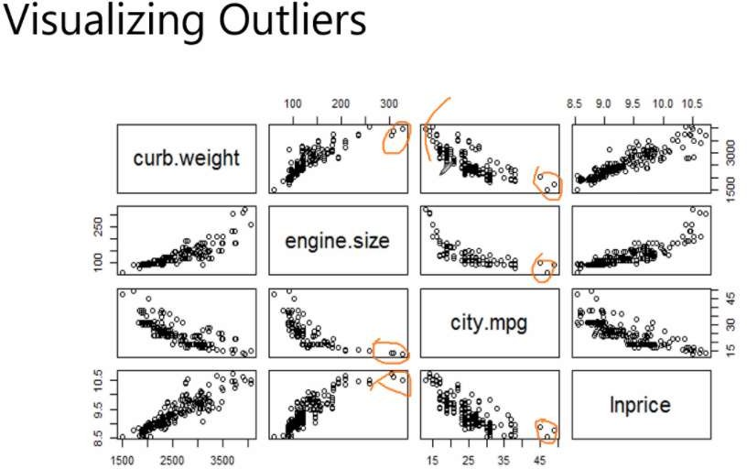
4/26/2022

Slide 14
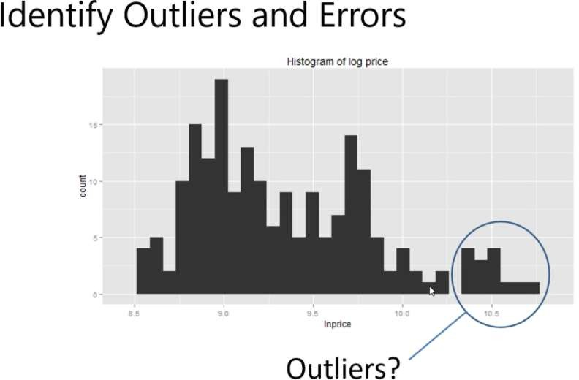
4/26/2022

Slide 15
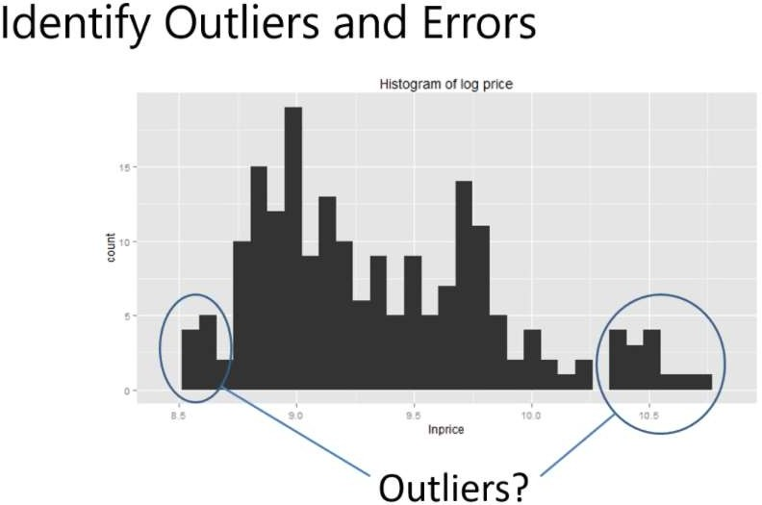
4/26/2022

Slide 16
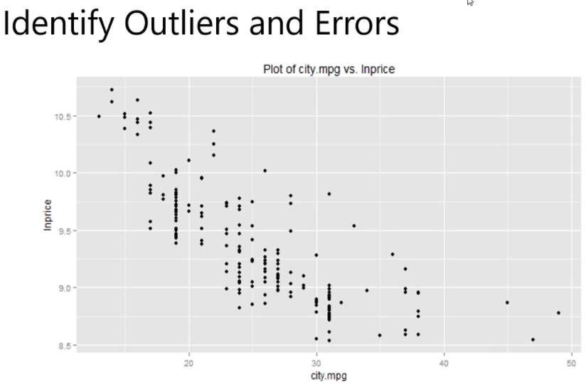
4/26/2022

Slide 17
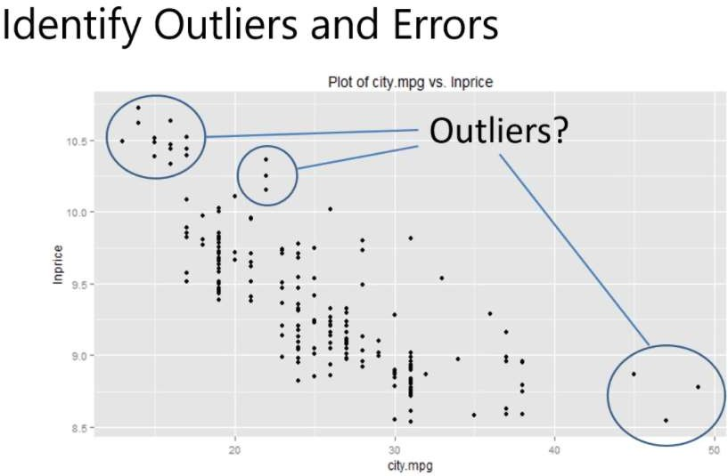
4/26/2022

Slide 18

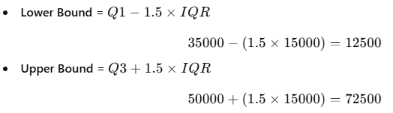


Sample Input (Original Data with Outliers)
calculate the Interquartile Range (IQR) for the given salary dataset.
Step-by-Step Calculation of IQR
Given the dataset: Salaries → [30000, 35000, 40000, 45000, 50000, 120000, 150000]
1. Calculate Q1 (25th percentile) and Q3 (75th percentile)
Q1 (First Quartile) = 35000
Q3 (Third Quartile) = 50000
2. Compute IQR
IQR=Q3−Q1=50000−35000=15000I
3. Define Outlier Bounds
4. Identify Outliers
Values below 12500 or above 72500 are considered outliers.
Outliers: 120000, 150000 (since they exceed 72500).

Slide 19
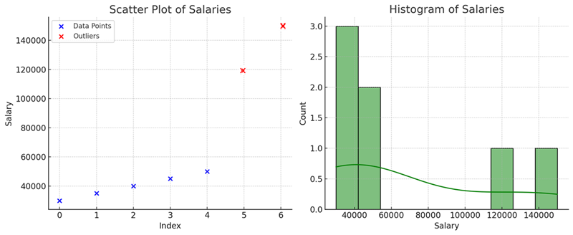

Slide 20
NOISY DATA
Noisy data refers to irrelevant, incorrect, or random variations in data that can distort analysis and predictions. It often includes:
🔹 Random errors – Mistakes in data entry (e.g., "50000" instead of "50,000"). 🔹 Outliers – Extreme values that don’t fit the pattern (e.g., age = 500). 🔹 Inconsistent data – Different formats or naming conventions (e.g., "NYC" vs. "New York"). 🔹 Duplicate data – Repeated entries that add redundancy.

Slide 21
HOW TO HANDLE NOISY DATA?
1. Binning (Smoothing)
Equal-width binning: Divide data into equal-sized bins and replace values with the mean or median of the bin.
Equal-frequency binning: Group values so each bin has an equal number of data points.
2. Regression (Trend Fitting)
Fit a regression line (linear or polynomial) to smooth the data.
Replace noisy values with predicted values from the regression model.
3. Moving Average (Rolling Window)
Use a sliding window over the data and replace each value with the mean or median of the window.
Example: 3-point or 5-point moving average.
4. Outlier Removal
Use Interquartile Range (IQR) or Z-score to identify and remove extreme values.
5. Clustering
Use K-Means or DBSCAN to detect and remove noise by identifying data points that do not belong to any meaningful cluster.
4/26/2022

Slide 22
HOW TO HANDLE NOISY DATA?
Steps for Binning:
Sort the Data: Arrange the dataset in ascending order.
Divide into Bins: Split the data into equal-sized bins (e.g., fixed-width or frequency-based).
Smooth the Data: Replace bin values using one of the following methods:
Bin Mean: Replace all values in a bin with the mean of the bin.
Bin Median: Replace values with the median of the bin.
Bin Boundary: Replace values with the closest minimum or maximum value in the bin.
Example:
Given data: [5, 7, 8, 10, 12, 15, 18, 22, 25]
Divide into bins: [5,7,8], [10,12,15], [18,22,25]
Apply Bin Mean: [6.67, 6.67, 6.67], [12.33, 12.33, 12.33], [21.67, 21.67, 21.67]
Binning effectively smooths fluctuations and reduces noise in data.

Slide 23
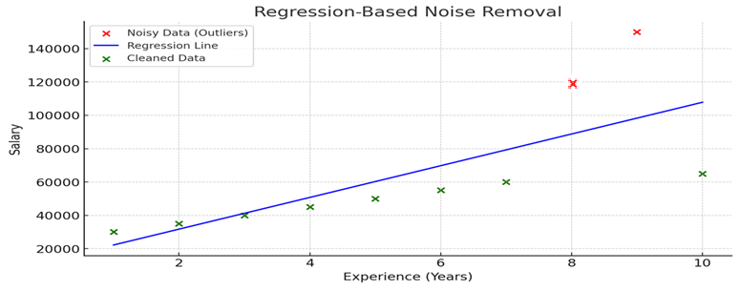
HOW TO HANDLE NOISY DATA?
how Regression helps remove noisy data (outliers):
🔴 Red Points → Noisy Data (Outliers) like 120000 & 150000.
🔵 Blue Line → Regression Trend Line (Best Fit).
🟢 Green Points → Cleaned Data (Closer to the trend).

Slide 24
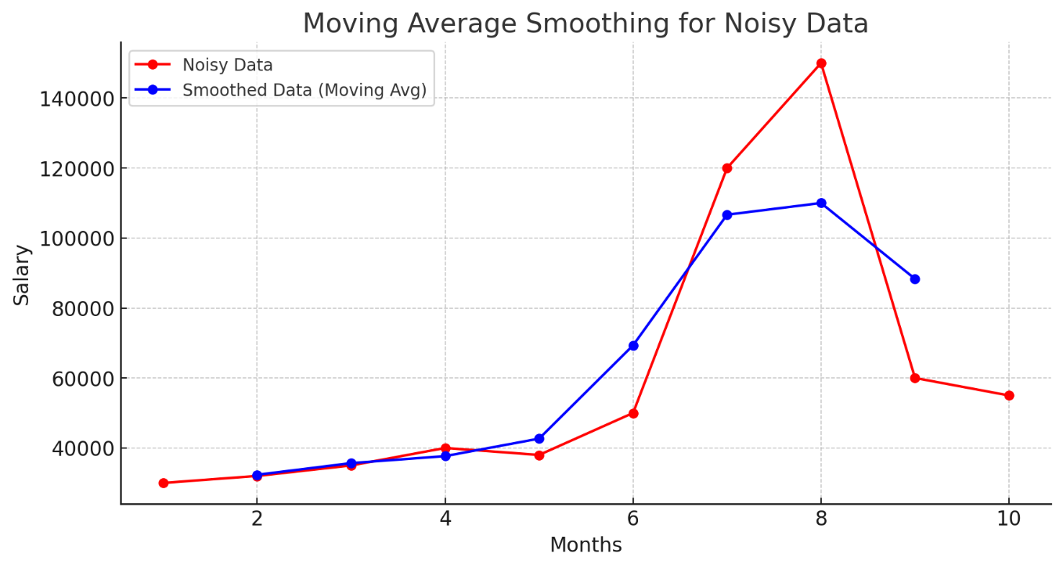
HOW TO HANDLE NOISY DATA?
how Moving Average (Rolling Window) helps smooth noisy data:
🔴 Red Line → Original Noisy Salaries (with outliers).
🔵 Blue Line → Smoothed Salaries using a 3-month moving average.
💡 How it works:
Each data point is replaced with the average of itself and its neighbors (3-point window).
This reduces fluctuations and smooths trends

Slide 25
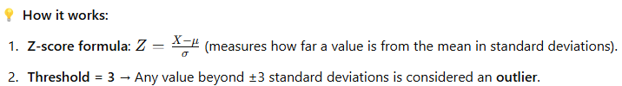
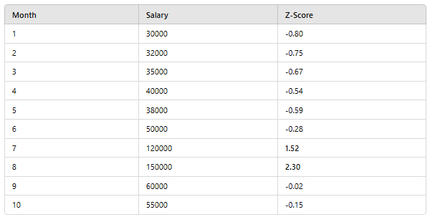
HOW TO HANDLE NOISY DATA?
🔴 Outliers: Salaries 120000 & 150000 have high Z-scores (> 3 is typically an outlier).
✅ Now we can remove these extreme values to clean the data!

Slide 26
DATA INTEGRATION
Data Integration is the process of combining data from multiple sources into a unified, consistent, and meaningful dataset. It is essential in data cleaning to ensure that data from different systems can be used together effectively.
Why is Data Integration Important?
Data often comes from multiple sources (databases, spreadsheets, APIs, cloud storage, etc.).
Different datasets may have overlapping information (e.g., customer data from CRM & sales reports).
Inconsistencies and redundancies must be resolved to ensure high-quality data.

Slide 27
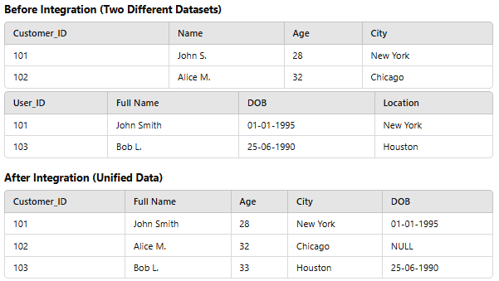

Slide 28
HANDLING REDUNDANCY IN DATA INTEGRATION
Redundancy in data integration occurs when the same data is stored multiple times across different sources. It can lead to inconsistencies, increased storage costs, and incorrect analysis.
Types of Redundancy in Data Integration
1. Duplicate Features – Two or more features providing the same information.
Example: total_price = quantity * price_per_unit, where total_price is redundant.
2. Highly Correlated Features – One feature can be predicted from another.
Example: height_cm and height_inches (one can be derived from the other).
3. Derived/Dependent Features – Features that store calculated values instead of raw data.
Example: age and date_of_birth (age can be derived from date_of_birth).
4. Multi-Collinearity – When independent variables are highly correlated.
Example: salary and income_after_tax, where tax can be estimated.

Slide 29
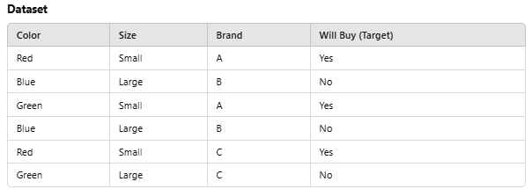
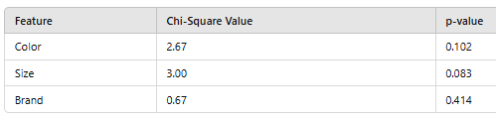
REDUNDANCY REMOVAL
Chi-Square Test (For Categorical Features)
The Chi-Square test measures whether a categorical feature is independent of the target variable. If a feature has high p-value (above 0.05), it does not contribute significantly and can be removed.
Brand has a high p-value (> 0.05), it does not significantly impact Will_Buy, so we remove it.

Slide 30
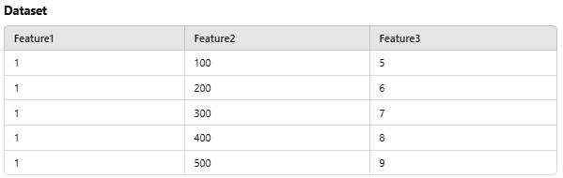
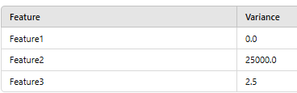
Variance Threshold (For Low-Variance Features)
If a feature has almost the same value for all records, it does not provide useful information. The Variance Threshold method removes such features.
Feature1 is removed because it has no variance (same value for all records).

Slide 31
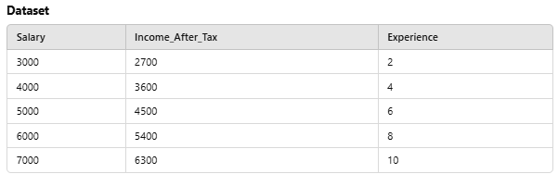
Correlation Analysis (For Highly Correlated Features)
Features that are highly correlated (> 0.9) provide duplicate information. One of them should be removed to avoid multicollinearity.
If Salary and Income_After_Tax have a correlation > 0.9, we drop one of them.

Slide 32
CATEGORICAL DATA ENCODING TECHNIQUES
Data Encoding is an important pre-processing step in Machine Learning. It refers to the process of converting categorical or textual data into numerical format, so that it can be used as input for algorithms to process. The reason for encoding is that most machine learning algorithms work with numbers and not with text or categorical variables.

Slide 33
WHY DATA ENCODING IS IMPORTANT?
Most machine learning algorithms work only with numerical data, so categorical variables (such as text labels) must be transformed into numerical values.
• This allows the model to identify patterns in the data and make predictions based on those patterns.
• Encoding also helps to prevent bias in the model by ensuring that all features are equally weighted.
• The choice of encoding method can have a significant impact on model performance, so it is important to choose an appropriate encoding technique based on the nature of the data and the specific requirements of the model

Slide 34
WHAT IS CATEGORICAL DATA?
When we collect data, we often encounter different types of variables. One such type is categorical variables. Categorical variables are usually represented as ‘strings’ or ‘categories’ and are finite in number.
There are two types of categorical data -
• Ordinal Data
• Nominal Data
Here are a few examples of categorical variables:
• Places: Delhi, Mumbai, Ahmedabad, Bangalore, etc.
• Departments: Finance, Human resources, IT, Production.
• Grades: A, A-, B+, B, B- etc.

Slide 35
WHAT IS CATEGORICAL DATA?
Ordinal Data:
The categories of ordinal data have an Inherent Order. This means that the categories can be Ranked or ordered from highest to lowest or vice versa.
For example, the variable “highest degree a person has” is an ordinal variable. The categories (High school, Diploma, Bachelors, Masters, PhD) can be ranked in order of the level of education attained.

Slide 36
WHAT IS CATEGORICAL DATA?
Nominal Data:
The categories of nominal data do not have an Inherent Order. This means that the categories cannot be ranked or ordered.
For example, the variable “city where a person lives” is a nominal variable. The categories (Delhi, Mumbai, Ahmedabad, Bangalore, etc.) cannot be ranked or ordered.

Slide 37
SEVERAL METHODS FOR ENCODING CATEGORICAL VARIABLES
1. One-Hot Encoding
2. Dummy Encoding
3.Ordinal Encoding
4. Binary Encoding
5. Count Encoding
6. Target Encoding

Slide 38
ONE HOT ENCODING
One-Hot Encoding is the Most Common method for encoding Categorical variables.
• a Binary Column is created for each Unique Category in the variable.
• If a category is present in a sample, the corresponding column is set to 1, and all other columns are set to 0.
• For example, if a variable has three categories ‘A’, ‘B’ and ‘C’, three columns will be created and a sample with category ‘B’ will have the value [0,1,0].

Slide 39
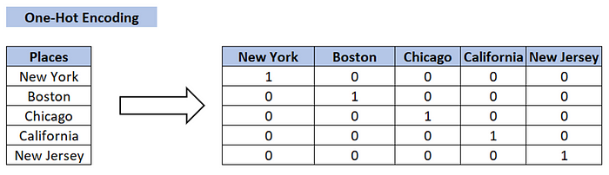

Slide 40
DUMMY ENCODING
Dummy coding scheme is similar to one-hot encoding.
• This categorical data encoding method transforms the categorical variable into a set of binary variables [0/1].
• In the case of one-hot encoding, for N categories in a variable, it uses N binary variables.
• The dummy encoding is a small improvement over one-hot-encoding. Dummy encoding uses N-1 features to represent N labels/categories.

Slide 41
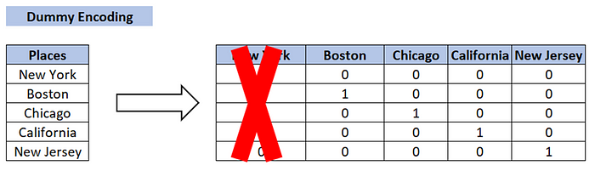
One-Hot Encoding vs Dummy Encoding:
One-Hot Encoding — N categories in a variable, N binary variables.
Dummy encoding — N categories in a variable, N-1 binary variables.

Slide 42
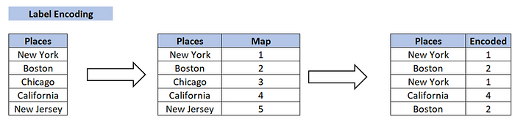
LABEL ENCODING:
Each unique category is assigned a Unique Integer value.
This is a simpler encoding method, but it has a Drawback in that the assigned integers may be misinterpreted by the machine learning algorithm as having an Ordered Relationship when in fact they do not.

Slide 43
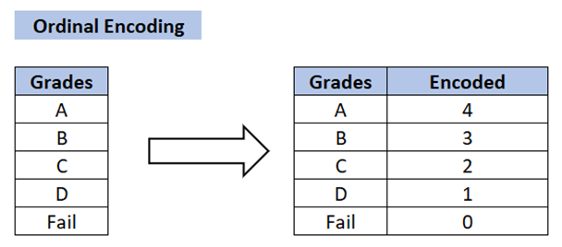
ORDINAL ENCODING:
Ordinal Encoding is used when the categories in a variable have a Natural Ordering.
• In this method, the categories are assigned a numerical value based on their order, such as 1, 2, 3, etc.
For example, if a variable has categories ‘Low’, ‘Medium’ and ‘High’, they can be assigned the values 1, 2, and 3, respectively.

Slide 44
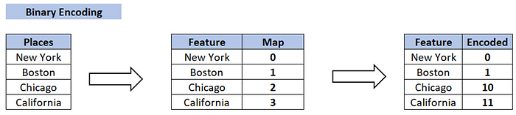
BINARY ENCODING:
Binary Encoding is similar to One-Hot Encoding, but instead of creating a separate column for each category, the categories are represented as binary digits.
For example, if a variable has four categories ‘A’, ‘B’, ‘C’ and ‘D’, they can be represented as 0001, 0010, 0100 and 1000, respectively.

Slide 45
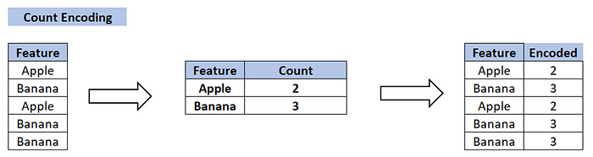
COUNT ENCODING:
• Count Encoding is a method for encoding categorical variables by counting the number of times a category appears in the dataset.
For example, if a variable has categories ‘A’, ‘B’ and ‘C’ and category ‘A’ appears 10 times in the dataset, it will be assigned a value of 10.

Slide 46
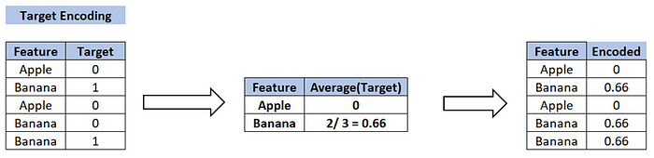
TARGET ENCODING:
This is a more advanced encoding technique used for dealing with high cardinality categorical features, i.e., features with many unique categories.
• The average target value for each category is calculated and this average value is used to replace the categorical feature.
This has the advantage of considering the relationship between the target and the categorical feature, but it can also lead to overfitting if not used with caution.

Slide 47
IMPORTANCE OF DATA TYPE SELECTION FOR MODELING
Selecting the appropriate data type is crucial in modeling as it directly impacts accuracy, efficiency, and interpretability. Below are key reasons why data type selection matters:
Accuracy and Precision
Incorrect data types can lead to loss of precision (e.g., using an integer instead of a float for continuous values).
Choosing the right type prevents rounding errors and ensures correct computations.
Memory and Computational Efficiency
Large datasets benefit from optimized data types (e.g., using int8 instead of int64 for small numbers reduces memory usage).
Efficient data types improve processing speed, especially in machine learning and big data applications.

Slide 48
3. Data Integrity and Validation
Ensures consistency and prevents errors (e.g., storing categorical data as integers vs. strings can affect how algorithms process them).
Type mismatches can cause unintended behaviors in models.
4. Algorithm Compatibility
Some machine learning models require specific data types (e.g., decision trees work better with categorical data encoded as integers).
Incorrect data types can lead to errors or suboptimal performance.
5. Interpretability and Feature Engineering
Properly defining categorical vs. numerical data helps in feature selection and transformation.
Using appropriate types allows for meaningful statistical analysis.

Slide 49
DATA REDUCTION STRATEGIES
Data reduction: Obtain a reduced representation of the data set that is much smaller in volume but yet produces the same (or almost the same) analytical results
Why data reduction? — A database/data warehouse may store terabytes of data. Complex data analysis may take a very long time to run on the complete data set.
Data reduction strategies
Dimensionality reduction, e.g., remove unimportant attributes
−Wavelet transforms
−Principal Components Analysis (PCA)
−Feature subset selection, feature creation
Numerosity reduction (some simply call it: Data Reduction)
−Regression and Log-Linear Models
−Histograms, clustering, sampling
−Data cube aggregation
Data compression
4/26/2022

Slide 50
DATA REDUCTION 1: DIMENSIONALITY REDUCTION
Curse of dimensionality
When dimensionality increases, data becomes increasingly sparse
Density and distance between points, which is critical to clustering, outlier
analysis, becomes less meaningful
The possible combinations of subspaces will grow exponentially
Dimensionality reduction
Avoid the curse of dimensionality
Help eliminate irrelevant features and reduce noise
Reduce time and space required in data mining
Allow easier visualization
Dimensionality reduction techniques
Wavelet transforms
Principal Component Analysis
Supervised and nonlinear techniques (e.g., feature selection)
4/26/2022

Slide 51
DATA NORMALIZATION
Normalization is used to scale the data of an attribute so that it falls in a smaller range, such as -1.0 to 1.0 or 0.0 to 1.0.
It is generally useful for classification algorithms.
4/26/2022

Slide 52
NEED OF NORMALIZATION
Normalization is generally required when we are dealing with attributes on a different scale, otherwise, it may lead to a dilution in effectiveness of an important equally important attribute(on lower scale) because of other attribute having values on larger scale.
In simple words, when multiple attributes are there but attributes have values on different scales, this may lead to poor data models while performing data mining operations. So they are normalized to bring all the attributes on the same scale.
4/26/2022

Slide 53
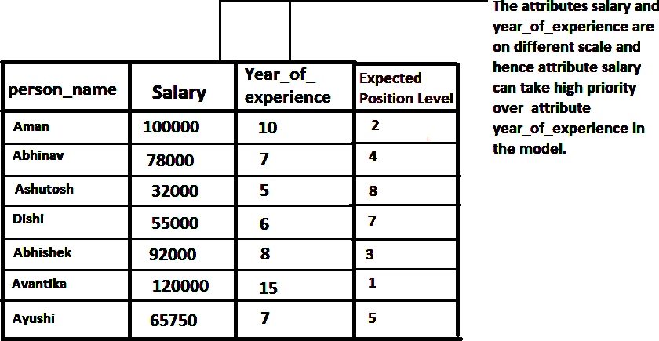
4/26/2022

Slide 54
Min-Max Normalization: This transforms the original data linearly.
Suppose that: min_A is the minima and max_A is the maxima of an attribute, P
We Have the Formula:
4/26/2022

Slide 55

Where v is the value you want to plot in the new range.
v’ is the new value you get after normalizing the old value.
Solved example:
Suppose the minimum and maximum value for an attribute profit(P) are Rs. 10, 000 and Rs. 100, 000. We want to plot the profit in the range [0, 1]. Using min-max normalization the value of Rs. 20, 000 for attribute profit can be plotted to:
And hence, we get the value of v’ as 0.11
4/26/2022

Slide 56
Z-Score Normalization:In z-score normalization (or zero-mean normalization) the values of an attribute (A), are normalized based on the mean of A and its standard deviation
A value, v, of attribute A is normalized to v’ by computing
4/26/2022

Slide 57

For example:
Let mean of an attribute P = 60, 000, Standard Deviation = 10, 000, for the attribute P. Using z-score normalization, a value of 85000 for P can be transformed to:
And hence we get the value of v’ to be 2.5
4/26/2022

Slide 58
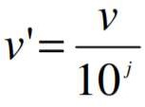
Decimal Scaling:
It normalizes the values of an attribute by changing the position of their decimal points
The number of points by which the decimal point is moved can be determined by the absolute maximum value of attribute A.
A value, v, of attribute A is normalized to v’ by computing
where j is the smallest integer such that Max(|v’|) < 1.
4/26/2022

Slide 59
For example:
Suppose: Values of an attribute P varies from -99 to 99.
The maximum absolute value of P is 99.
For normalizing the values we divide the numbers by 100 (i.e., j = 2) or (number of integers in the largest number) so that values come out to be as 0.98, 0.97 and so on.
4/26/2022

Slide 60
FEATURE ENGINEERING AND ITS ROLE IN DATA PROCESSING
What is Feature Engineering?
Feature engineering is the process of transforming raw data into meaningful features that improve the performance of machine learning models. It involves selecting, creating, modifying, or encoding features to make them more useful for model training.
4/26/2022

Slide 61
ROLE OF FEATURE ENGINEERING IN DATA PROCESSING
Feature engineering plays a crucial role in the data processing pipeline, ensuring that the data fed into machine learning models is structured, relevant, and optimized for performance.
Handling Raw Data
Creating Interaction Features
Improving Model Performance
Scaling & Normalization
Reducing Dimensionality
Encoding Categorical Data
Handling Missing Values
4/26/2022

Slide 62
WHY IS FEATURE ENGINEERING IMPORTANT?
Better Model Accuracy: Enhances the quality of input data, leading to improved predictive performance.
Faster Training & Inference: Reduces complexity and training time by eliminating redundant features.
Reduces Overfitting: Ensures models generalize well to unseen data.
Makes Data More Understandable: Helps data scientists and stakeholders interpret model

Slide 63
ETL IN FEATURE ENGINEERING
ETL (Extract, Transform, Load) is a critical process in feature engineering that prepares raw data for machine learning models. It involves extracting data from multiple sources, transforming it into a structured and usable format, and loading it into a data repository for analysis.

Slide 64
STEPS OF ETL IN FEATURE ENGINEERING
Step 1: Extract (E) – Collecting Raw Data
Data is gathered from various sources such as databases, APIs, files (CSV, JSON, XML), web scraping, or logs.
Handles structured, semi-structured, and unstructured data.
Ensures data consistency and removes duplicates.
Example: Extracting customer transaction data from a SQL database and social media engagement data from an API.

Slide 65
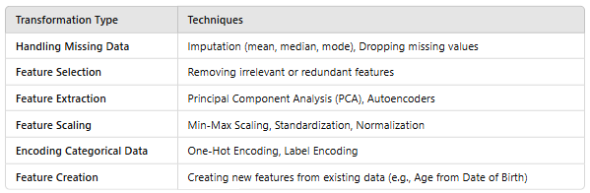
STEPS OF ETL IN FEATURE ENGINEERING
Step 2: Transform (T) – Cleaning & Feature Engineering
Converts raw data into a format suitable for machine learning.
Key feature engineering techniques applied in this step include:
Example:
Converting timestamps into day-of-week and hour-of-day features.
Binning customer age into groups (Young, Middle-Aged, Senior).

Slide 66
STEPS OF ETL IN FEATURE ENGINEERING
Step 3: Load (L) – Storing Processed Data
Stores transformed data in a data warehouse, data lake, or ML pipeline for further analysis.
Ensures data is ready for model training by organizing it efficiently.
Example:
Saving the final dataset into a PostgreSQL database for machine learning.
Exporting data as a Parquet or CSV file for further processing in Pandas or Spark.

Slide 67
IMPORTANCE OF ETL IN FEATURE ENGINEERING
Ensures Data Quality – Cleans, formats, and organizes data for machine learning.
Enhances Model Performance – Removes noise and improves feature relevance.
Handles Large-Scale Data – Optimizes processing for big data frameworks (Spark, Hadoop).
Automates Data Pipeline – Makes feature engineering scalable and reproducible.

